Slide 1
SpendWise Intelligent Personal Finance Management System
Graduation Project
Prepared by: Khaled Ayoub
Supervisor :Dr. Raed Bulbul
Department:IT
University: Al-Aqsa
Year2026 :

Slide 2
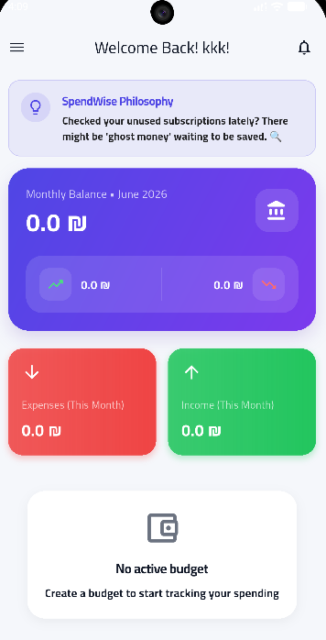
Project Background
Increasing digital expenses.
Difficulty tracking subscriptions.
Lack of financial awareness.
Existing applications depend on Internet.
Need for intelligent offline financial management.

Slide 3
Problem Statement
Manual expense tracking is inefficient.
Existing applications are complicated.
Heavy dependence on cloud services.
Privacy concerns.
No predictive financial assistance.

Slide 4
Motivation & Objectives
Motivation
Help users control spending.
Improve financial awareness.
Offline accessibility.
Privacy protection.
Objectives
Smart budgeting
AI advisor
Reports
Analytics
Secure synchronization

Slide 5
Related Work
Prediction | Reports | AI | Offline | System
❌ | ✔ | ❌ | ❌ | Mint
❌ | ✔ | ❌ | ❌ | YNAB
❌ | ✔ | ❌ | Limited | Spendee
❌ | Limited | ❌ | ✔ | GoodBudget
✔ | ✔ | ✔ | ✔ | SpendWise

Slide 6
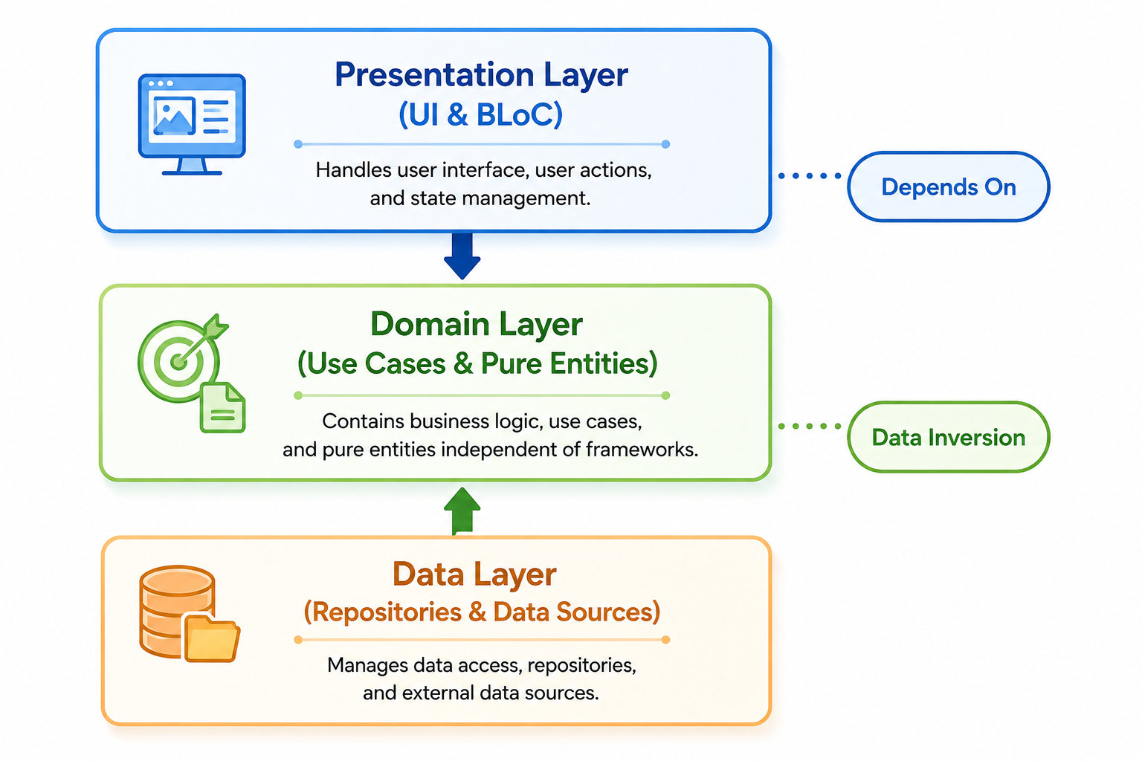
Methodology XP Lifecycle
Planning
↓
Design
↓
Implementation
↓
Testing
↓
Deployment
Figure 1.1

Slide 7
System Users
User
Register
Login
Manage expenses
Manage income
Reports
Budget
AI Advisor
Admin
Manage users
Broadcast notifications
Monitor sessions
Dashboard

Slide 8
System Architecture
Flutter App
↓
Presentation Layer
↓
Riverpod
↓
Repository
↓
SQLite
↓
Firebase
↓
Cloud
Local First Architecture

Slide 9
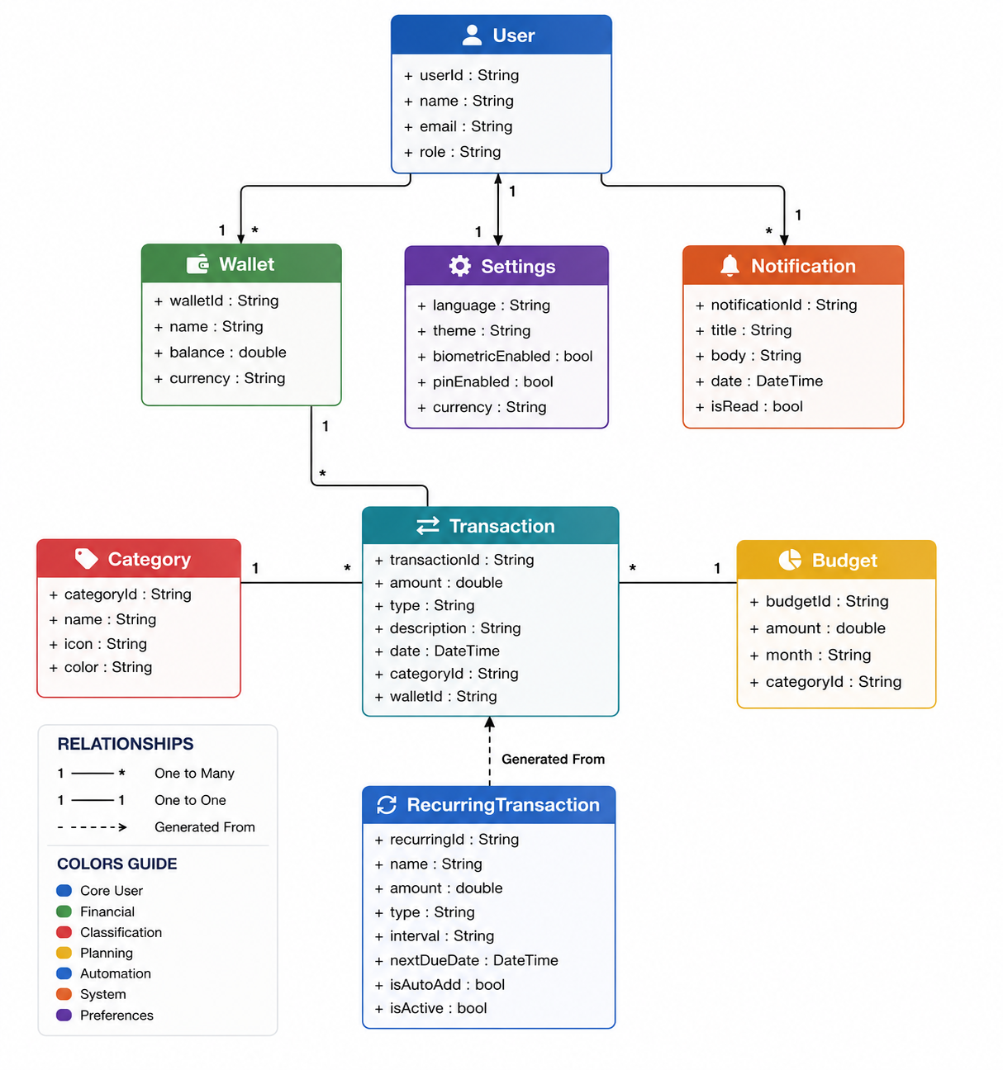
ER Diagram
Relations between entities

Slide 10
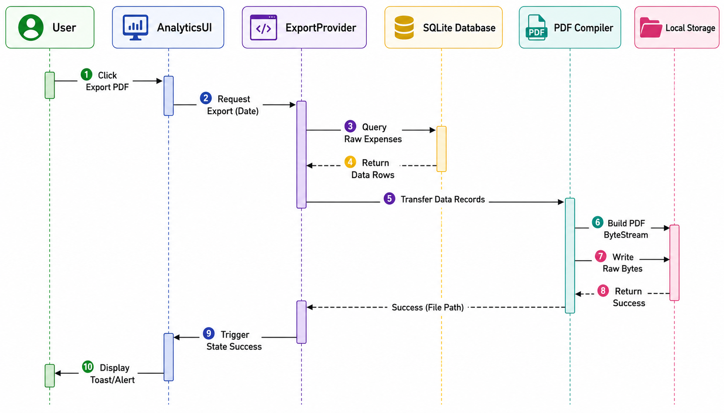
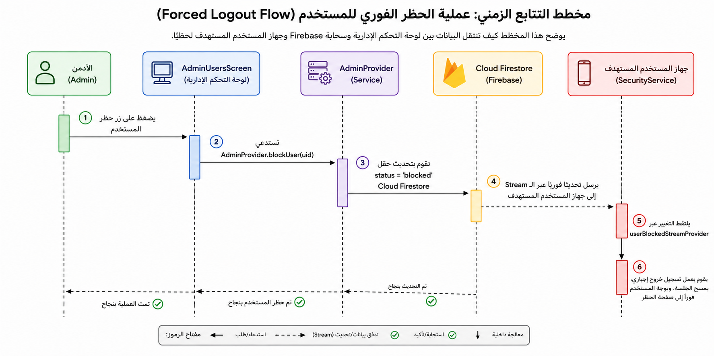
Sequence Diagram

Slide 11
Technology Stack
🩵 Framework | 💙 Backend | 💚 Storage | 🟣 Security
Flutter | Firebase | SQLite | SHA-256
Dart | Firestore | SharedPreferences | Local Authentication
🟠 State Management | 🔵 AI | 🟢 Reports | ⚙️ Architecture
Riverpod | Gemini AI API | PDF | Clean Architecture
 | Chat GPT | Excel | Repository Pattern
 |  |  | Local-First

Slide 12
Core Features
Financial Management
Income
Expense
Wallet
Budget
Smart Features
AI Advisor
Burn Rate
Prediction
Notifications
Reports

Slide 13
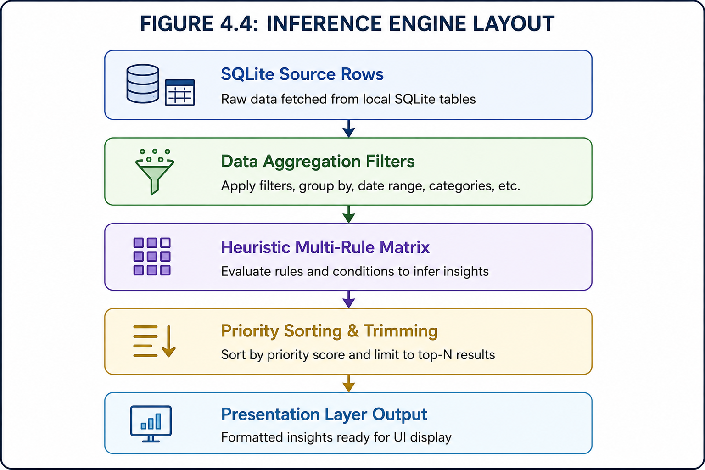
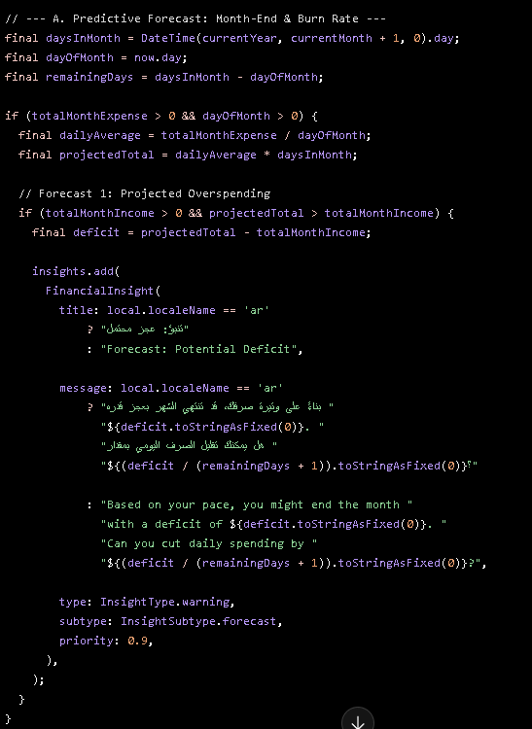
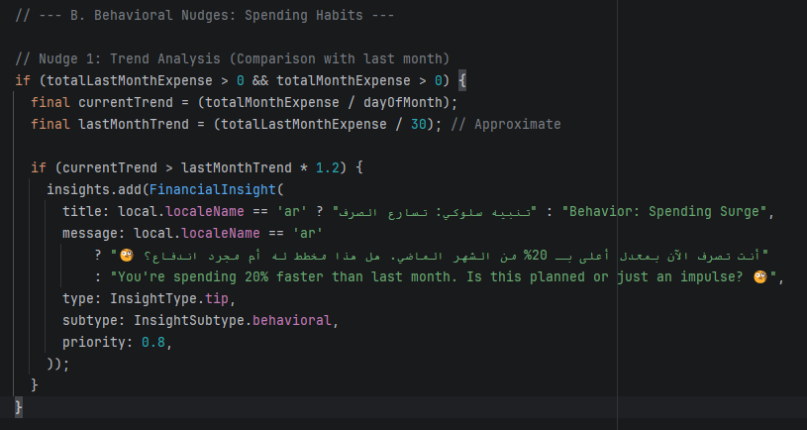
AI Advisor
AI Advisor analyses
↓
Daily spending
↓
Historical behavior
↓
Burn rate
↓
Forecast
↓
Smart recommendations

Slide 14
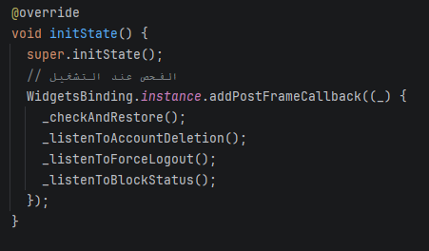
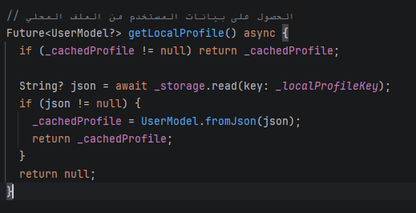
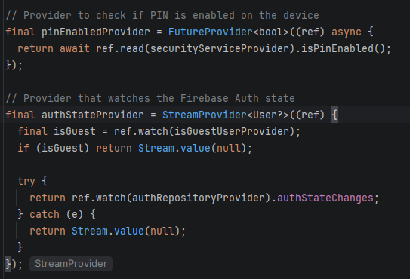
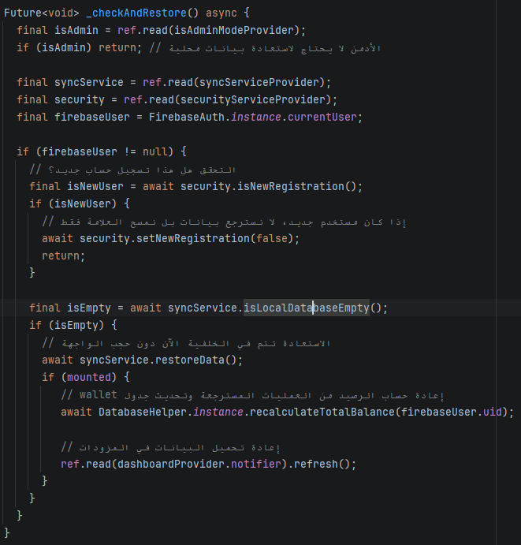
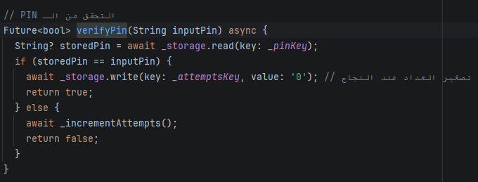
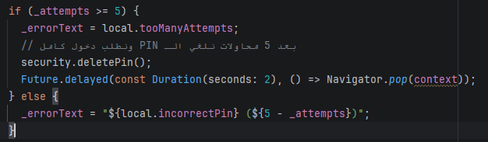
Security
SHA-256 PIN
Biometrics
Firebase Authentication
Session Validation
Secure Backup

Slide 15
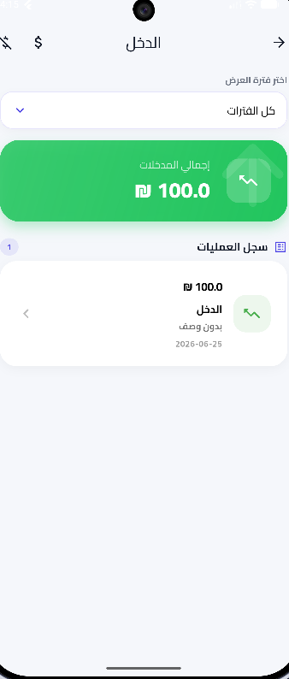
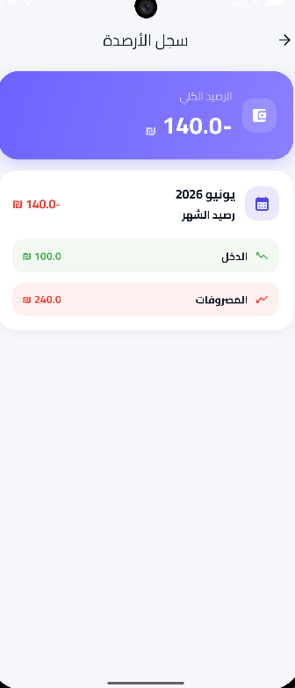
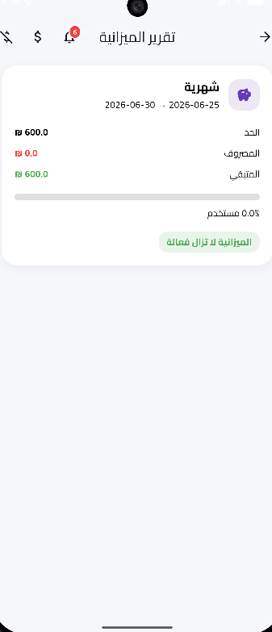
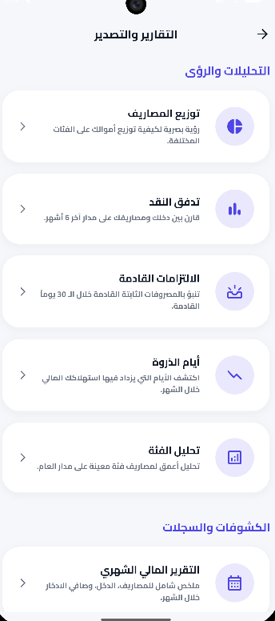
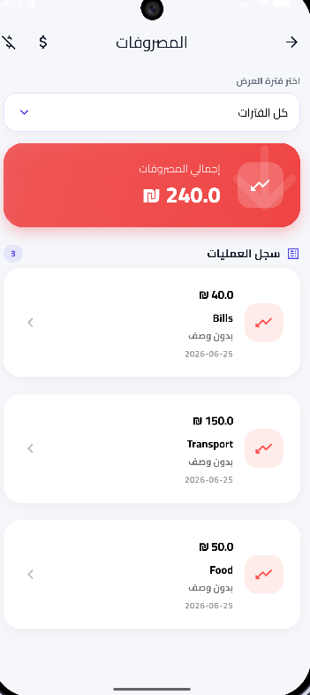
Application Screens
Dashboard
Expense
Income
Wallet
Budget
Reports

Slide 16
Results
✔ Offline transactions
✔ Secure synchronization
✔ Budget management
✔ AI prediction
✔ Fast performance
✔ PDF reports
✔ Excel reports
✔ Cross-platform

Slide 17
Conclusion
Developed a complete intelligent finance management application.
Local-first architecture ensures reliability.
AI improves financial awareness.
Secure and scalable system.
High performance using Flutter.

Slide 18
Future Work
OCR receipt scanning
Bank API integration
Investment tracking
Machine Learning models
Voice assistant
Web version
Desktop version

Slide 19
Thank You
Questions?

